Slide 1

Notes:
#

Slide 2

Team Introduction
Title:
AI-Powered Size Chart Generator for Apparel Sellers
Team Name:
TLE
Team Members:
Vaibhav Shukla (Team Leader)
Juhi Dwivedi (Team Member)
College/University:
Amity University
Date:
25-08-2024

Slide 3

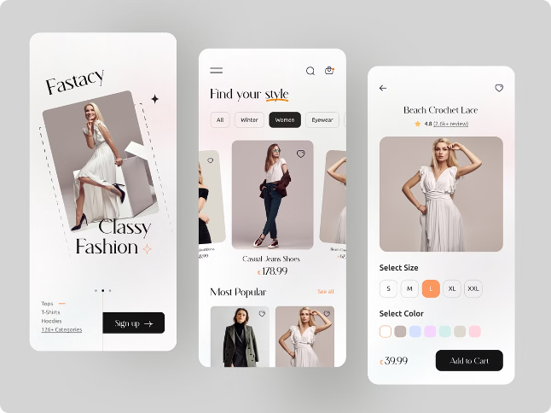
AI-Powered Size Chart Generator for Apparel Sellers
Our solution outlines an innovative AI-powered size chart generator designed to revolutionize the apparel shopping experience on Flipkart's e-commerce platform. The generator provides accurate size recommendations, enhances customer satisfaction, and streamlines the return process.

Slide 4
Overview of Flipkart's e-commerce platform
Flipkart is India's leading e-commerce platform, offering a vast selection of products across various categories, including apparel. The platform boasts a user-friendly interface, seamless checkout process, and a wide range of payment options.
Product Categories
Customer Base
Seller Network
Flipkart offers a diverse range of products, from electronics and home appliances to fashion and beauty.
Flipkart has a large and growing customer base, with millions of users making purchases on the platform.
The platform hosts a vast network of sellers, offering a wide selection of products and competitive pricing.

Slide 5


Executive Summary:
Problem Statement :
High return rates due to incorrect sizing are a significant issue for e-commerce platforms like Flipkart, leading to customer dissatisfaction and increased operational costs.
Current size charts are generic and don’t account for individual body variations.
Proposed Solution:
Implementing an AI-powered size chart generator that provides personalized size recommendations based on user body measurements, previous purchase history, and clustering analysis.
Key Objectives:
Reduce size-related returns.
Improve customer satisfaction.
Enhance the shopping experience by offering tailored recommendations.
Expected Impact:
Lower operational costs, increased customer loyalty, and strengthened competitive edge for Flipkart.

Slide 6





Improved Customer Experience with Tailored Recommendations
Accurate size recommendations are crucial for customer satisfaction in the online apparel market. When customers receive the correct size, they are more likely to be happy with their purchase and return for more.
Customer Profile
The generator collects customer data, such as height, weight, and measurements.
Style Preferences
The AI model analyzes customer purchase history and preferences to recommend sizes that fit their style.
Size Recommendation
The generator provides accurate size recommendations based on the collected data and algorithms.

Slide 7
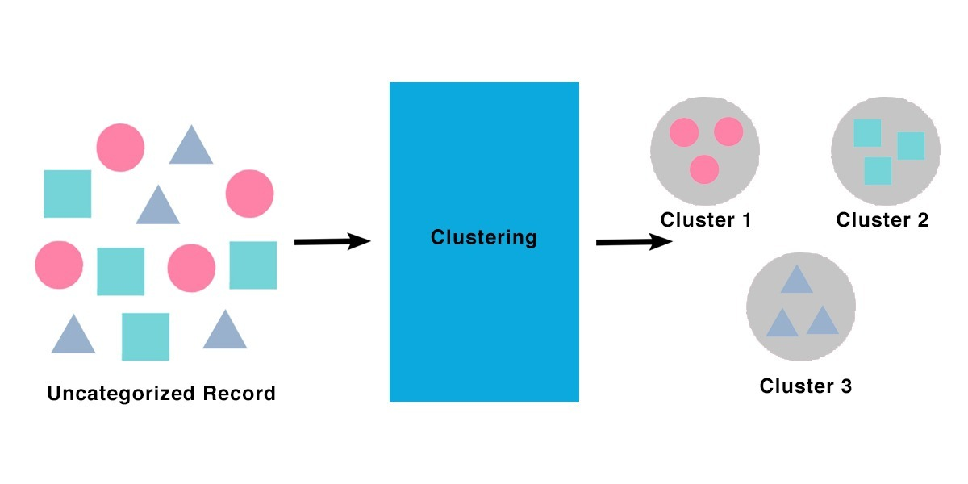
Technical Approach:
Methodology:
Clustering Algorithm: Utilizes Agglomerative Clustering to group users with similar body measurements and successful purchase histories.
Data Integration: Incorporates data from user measurements, purchase history, and return/exchange information to refine clusters and improve size accuracy.
Tools and Technologies:
Model Development
Python: Core language for model development.
Pandas: Data manipulation and preprocessing.
Scikit-Learn: Clustering, model training, and evaluation.
Joblib: Model saving and loading.
Matplotlib & Seaborn: Data visualization.
NumPy: Numerical computing for data processing.

Slide 8

Technical Approach:
Web App Integration
Flask/Django: Backend development and API creation.
React.js: Dynamic and responsive frontend.
Docker: Containerization for consistent deployment.
Gunicorn & Nginx: Production deployment and reverse proxy
Algorithm/Logic:
Prediction Process Overview
Measurements: [70, 150, 38, 32, 40] (height, weight, bust, waist, hips).
Step 1: Data is formatted into a list.
Step 2: The list is passed into the trained model.
Step 3: The model processes the data, comparing it to learned clusters.
Step 4: A cluster is predicted (e.g., Cluster 3).
Step 5: The cluster determines the recommended size.
Why It Works:
Data-Driven: Recommendations are based on real-world data patterns.
Holistic Approach: Considers multiple measurements for accurate sizing.
Scalability: Model can be retrained with new data for continued accuracy.

Slide 9
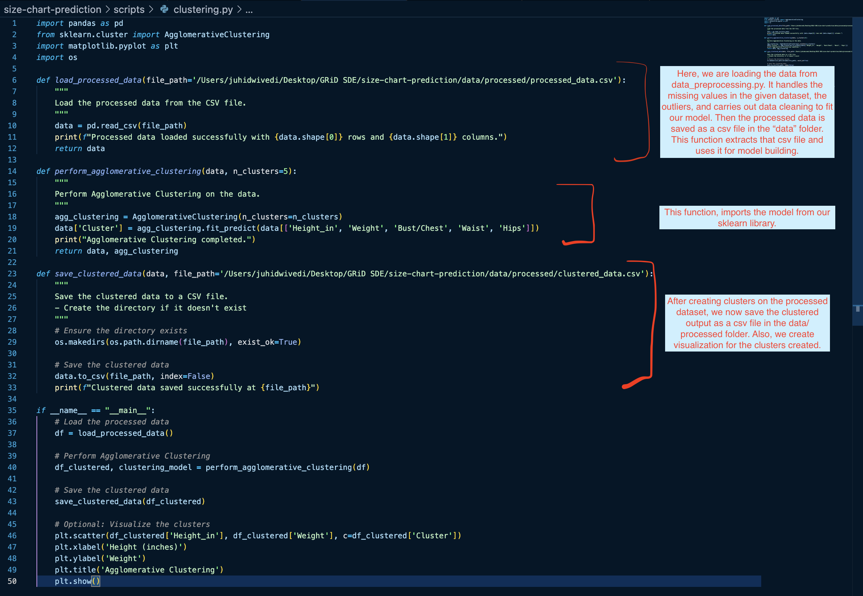
Technical Approach:
This code file performs Agglomerative Clustering on a dataset of body measurements to group similar individuals into clusters.
It first loads the processed data from a CSV file, then applies the clustering algorithm using key measurements like height, weight, and bust/chest size.
The resulting cluster labels are added to the data, which is then saved to a new CSV file.
Additionally, the code includes an optional visualization step to plot the clusters based on height and weight.

Slide 10
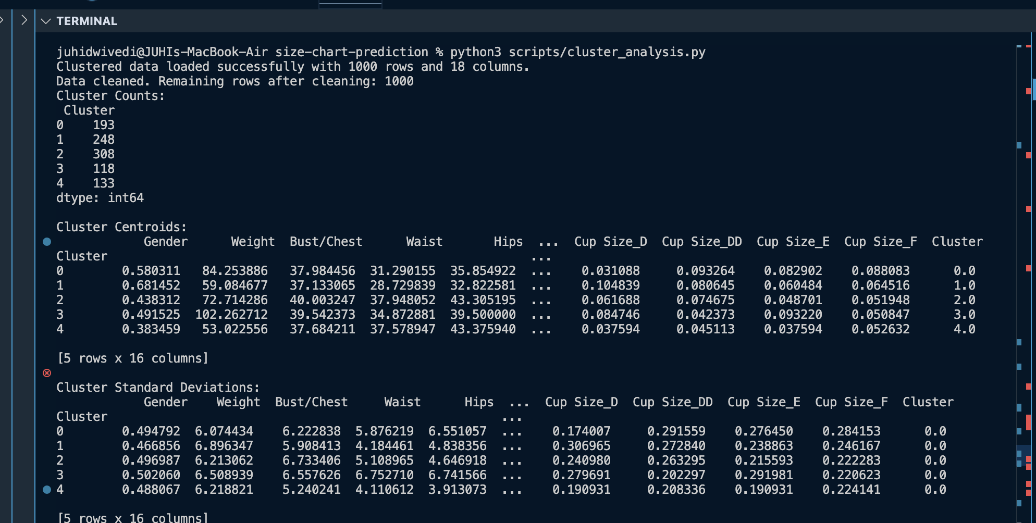
Technical Approach:
The cluster_analysis.py file performs statistical analysis and visualization of the clustered data obtained from the Agglomerative Clustering process.
It loads the clustered data, calculates key statistics such as cluster centroids and standard deviations, and generates visualizations to help understand the distribution and characteristics of each cluster.
This analysis provides insights into how different body measurements are grouped, aiding in the creation of personalized size charts and enhancing the overall understanding of the dataset.

Slide 11
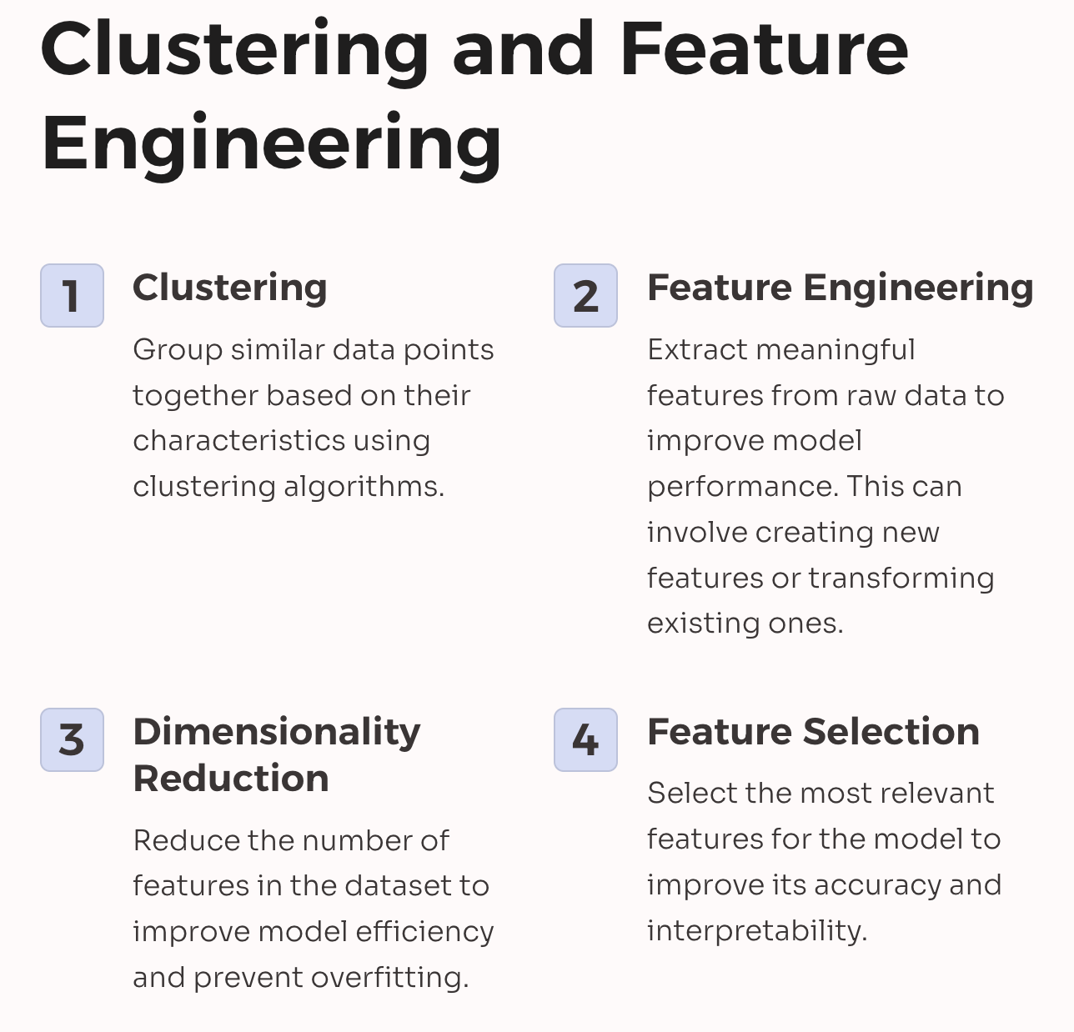
Technical Approach:
In the context of the AI-Powered Size Chart Generator, clustering is essential for identifying patterns and natural groupings within customer body measurements (such as height, weight, bust/chest size, waist size, and hips size).
By applying clustering techniques, specifically Agglomerative Clustering, we can group individuals with similar body measurements into distinct clusters.
These clusters represent different size categories or body shapes, which are crucial for generating personalized size charts.

Slide 12
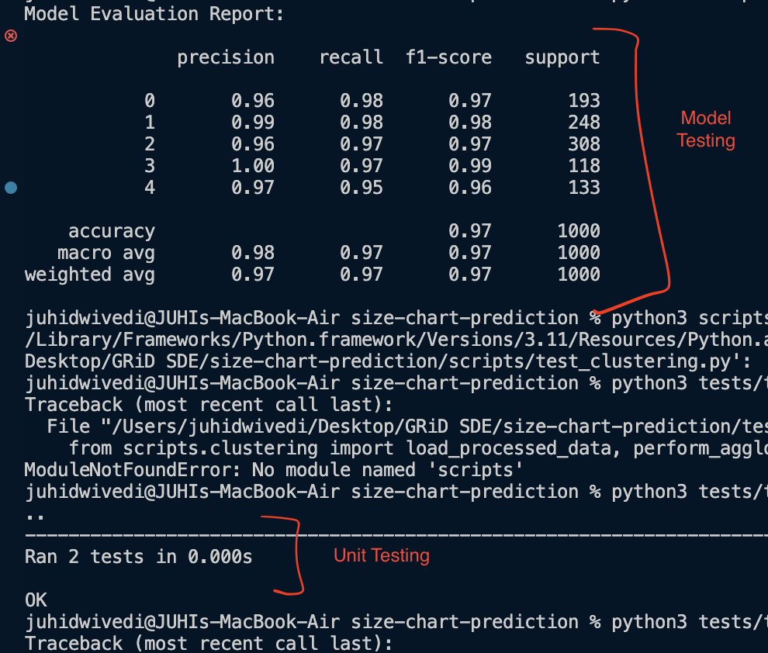
Technical Approach: Testing Approach
The testing approach for the AI Powered Size Chart Generator involved a combination of unit testing and validation to ensure the accuracy, reliability, and robustness of the various components in the project.
The primary goal was to validate that each module and function performed as expected, without introducing errors or inconsistencies.
The testing files are organized within the tests/ directory in the project structure. Each file in this directory corresponds to a specific aspect of the system, ensuring that all major functionalities are tested.

Slide 13

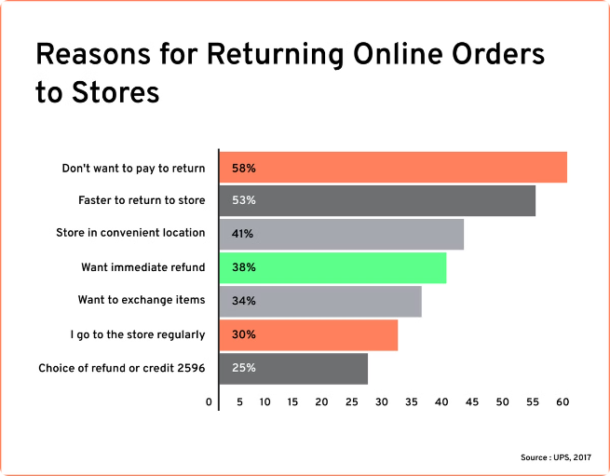
Reduction in Size-Related Returns
By providing accurate size recommendations, the AI-powered size chart generator aims to reduce the number of size-related returns, resulting in cost savings for both sellers and customers.
Reduced Shipping Costs
Improved Inventory Management
Fewer returns mean fewer shipments, leading to lower shipping costs for sellers and customers.
With fewer returns, sellers can better manage their inventory levels, ensuring that they have the right sizes in stock.
Enhanced Customer Satisfaction
Customers who receive the correct size are more likely to be satisfied with their purchase, leading to repeat business and positive reviews.

Slide 14
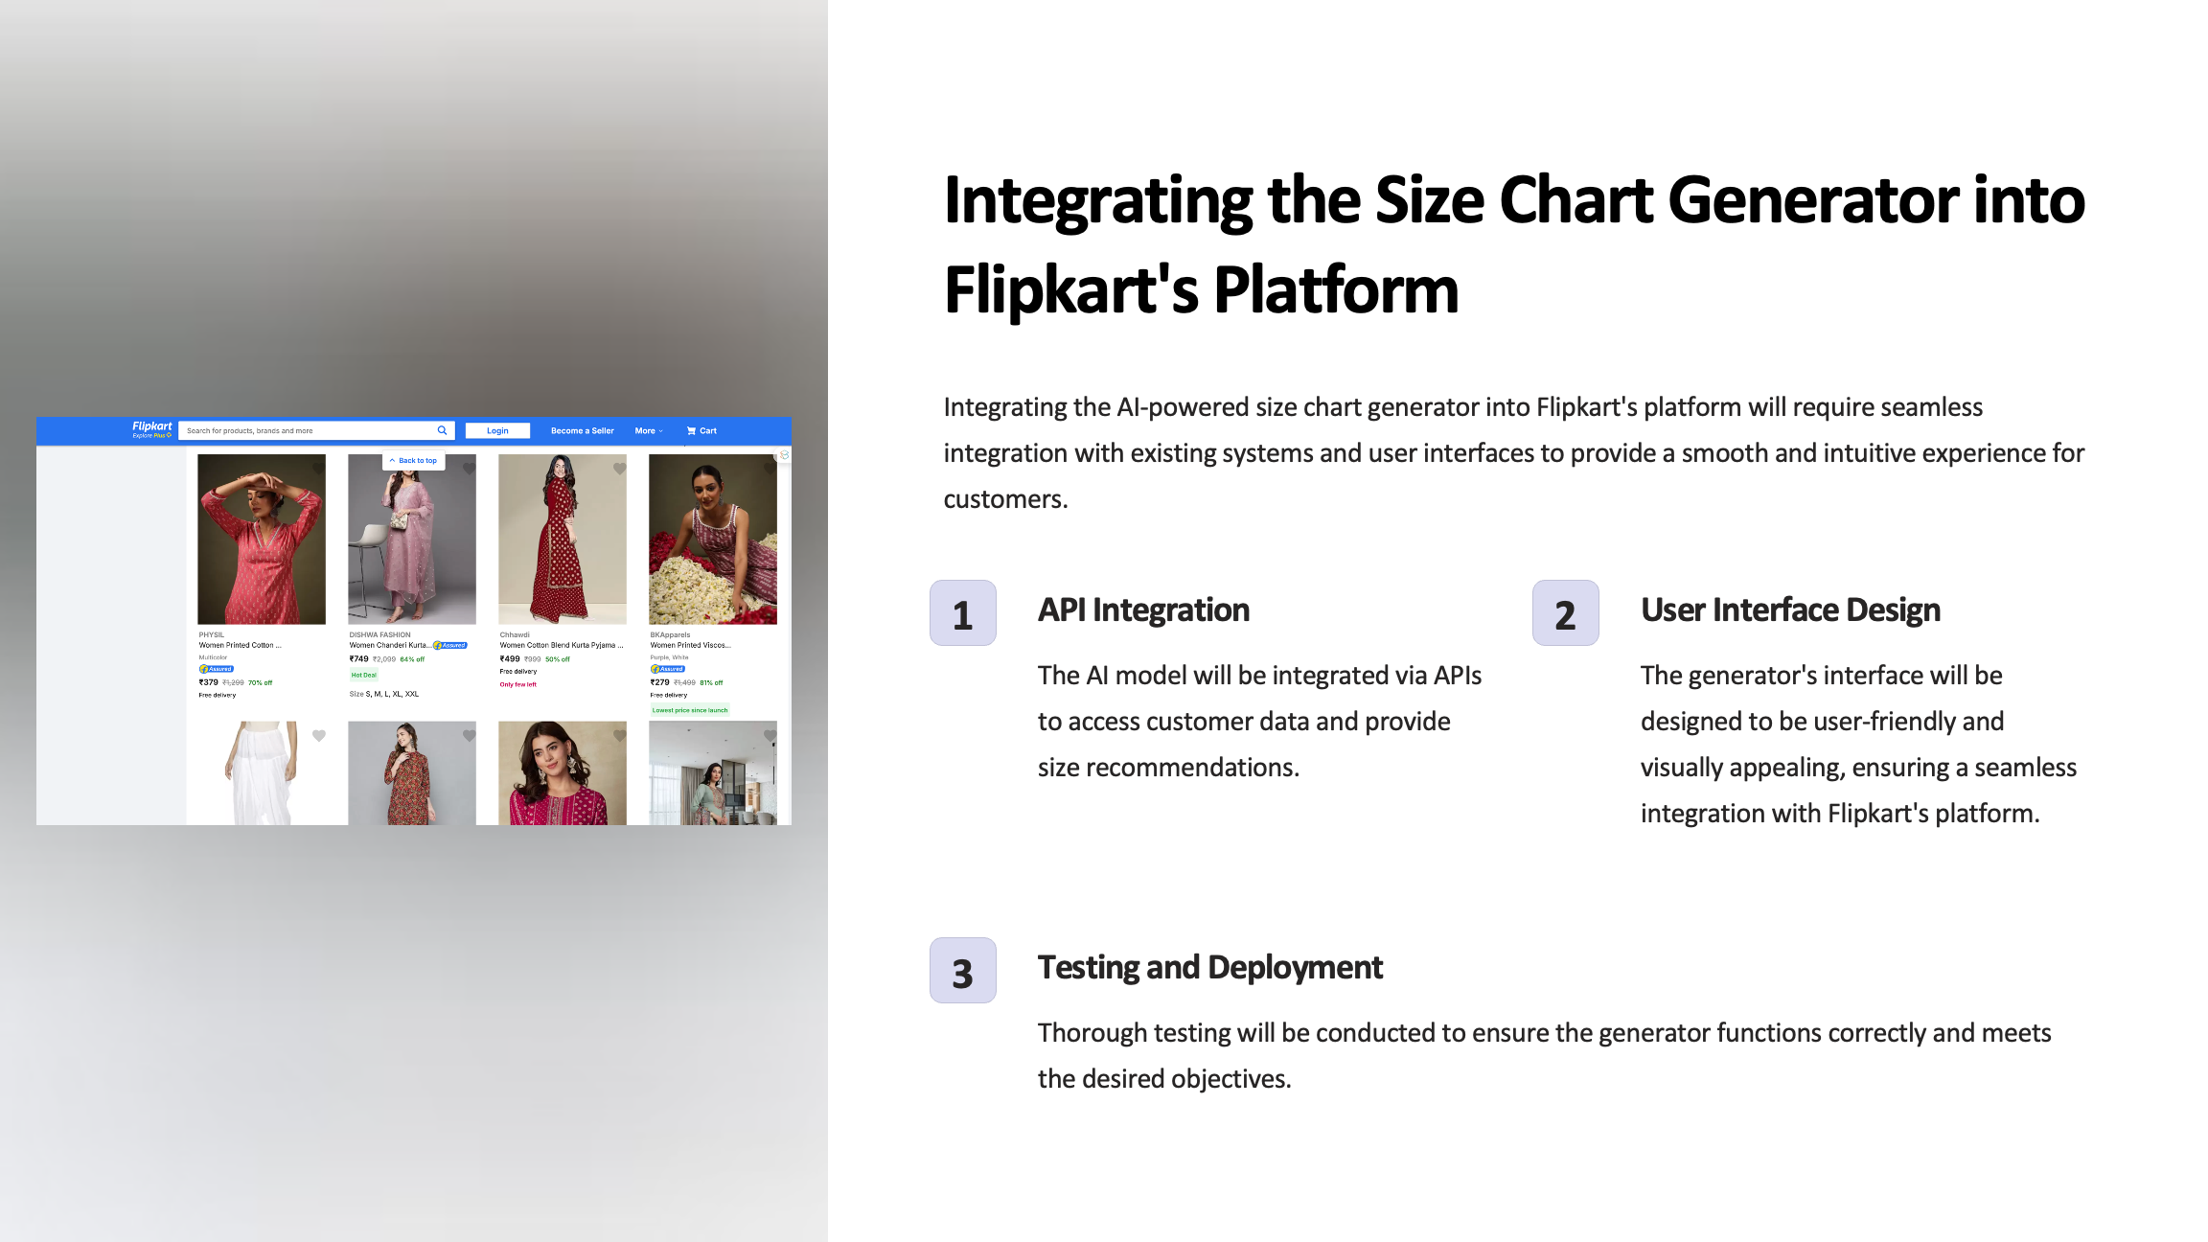

Slide 15






Key Objectives of the AI-Powered Size Chart Generator
The AI-powered size chart generator aims to address the challenges faced by apparel sellers on e-commerce platforms by providing accurate size recommendations, improving customer satisfaction, and reducing return rates.
Reduce Returns
Enhance Customer Satisfaction
The generator aims to minimize size-related returns by providing accurate size recommendations.
By offering tailored size recommendations, the generator strives to enhance the shopping experience and increase customer satisfaction.
Improve Shopping Experience
Data-Driven Insights
The generator provides personalized size suggestions, making the shopping process more convenient and efficient for customers.
The AI model analyzes data to identify patterns and predict customer preferences for accurate size recommendations.

Slide 16


How the Size Chart Generator Works
The AI-powered size chart generator uses machine learning algorithms to analyze vast amounts of data, including customer measurements, clothing styles, and feedback from previous purchases.
1
Data Collection
The AI model gathers data from customer measurements, garment dimensions, and past purchase history.
2
Algorithm Training
Machine learning algorithms are trained on the collected data to identify patterns and predict accurate size recommendations.
3
Size Recommendation
Based on the trained algorithms, the generator provides personalized size suggestions to customers during the shopping process.

Slide 17
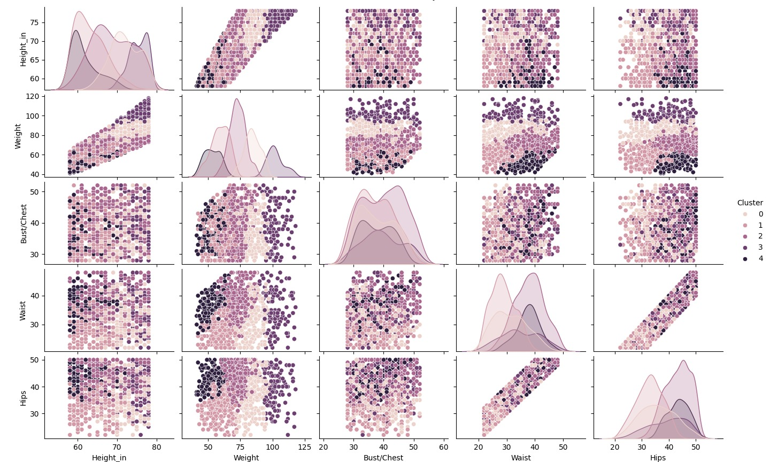
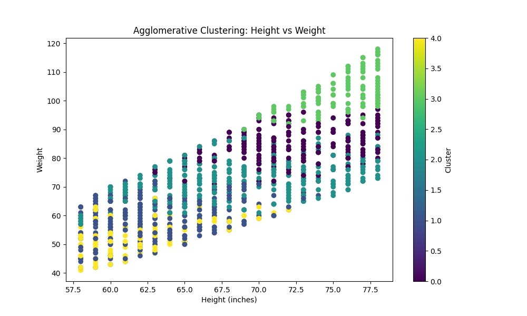
Results and Analysis:
These visualizations depict how body measurements like height, weight, bust, waist, and hips are grouped into distinct clusters. The patterns reveal correlations between features and how individuals with similar measurements are categorized into specific size groups.

Slide 18
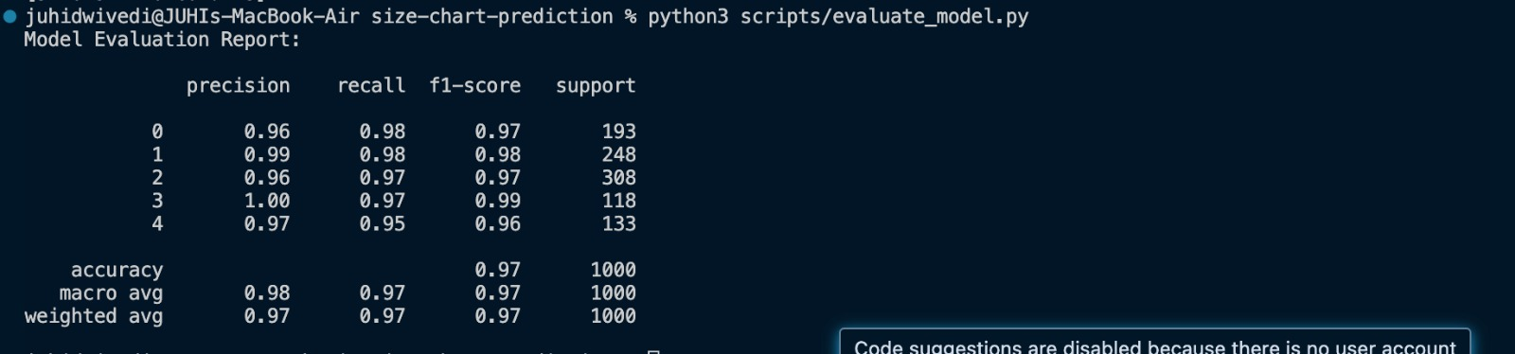
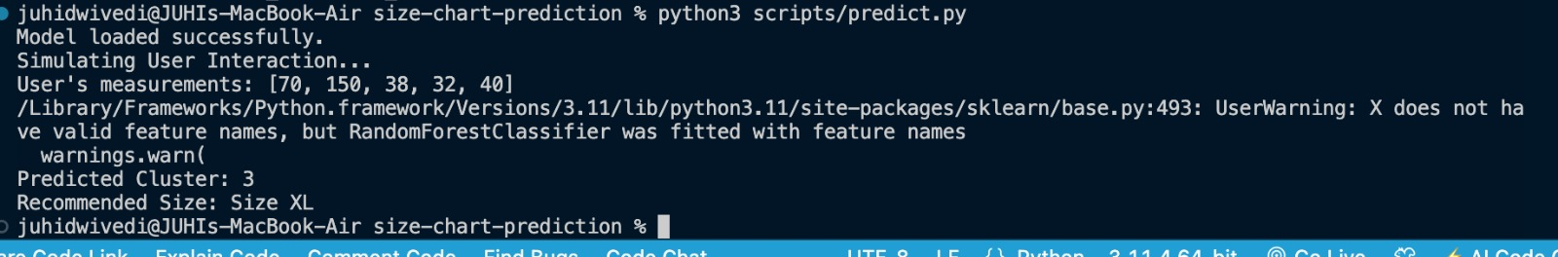
The first result shows the model's evaluation report, highlighting an overall accuracy of 97% across all clusters, with strong precision, recall, and f1-scores, indicating robust performance. The second result demonstrates a prediction example where the model successfully classified user measurements into Cluster 3 and recommended a size XL.

Slide 19
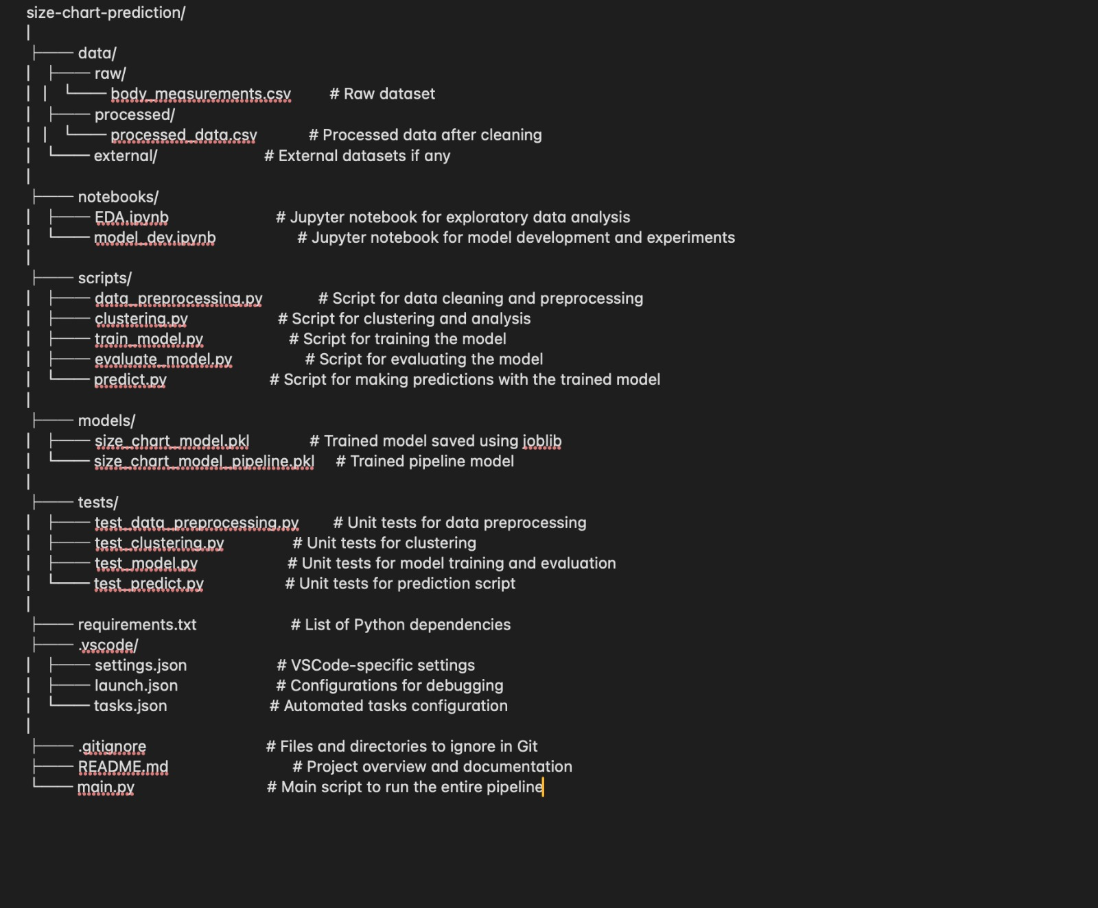
Hierarchy of Files

Slide 20
Challenges and Limitations:
During the development of the AI-Powered Size Chart Generator, we encountered several challenges and limitations, particularly related to data quality and handling missing values.
Missing Values and NaN Data: One of the significant challenges was dealing with missing values (NaN) in the dataset. Specifically, the height data, which is a crucial feature for clustering and model prediction, had several missing entries. When we initially attempted to clean the dataset by removing rows with NaN values, we found that it led to a substantial loss of data, effectively wiping out the majority of the dataset. This posed a significant challenge as it would undermine the model's ability to generalize and provide accurate predictions.
Handling Missing Data: To address this issue, we implemented strategies to handle missing data without compromising the integrity of the dataset. Instead of removing rows with missing values, we employed techniques such as imputing missing values with the most frequent value (mode) in the column or randomly selecting valid values from the existing data. This approach allowed us to retain the dataset's size and diversity while ensuring that the model could still learn from complete data.
Impact on Model Performance: While these strategies allowed us to preserve the dataset, they also introduced a limitation in terms of the potential accuracy and robustness of the model. Imputing missing values can sometimes introduce bias, especially if the missing data is not random. Additionally, the use of random valid values for imputation might not fully capture the true distribution of the missing data, which could affect the clustering outcomes and, subsequently, the size recommendations.
In conclusion, handling missing data, particularly in critical features like height, was a challenging aspect of this project. Although we successfully implemented strategies to mitigate the issue, the approach has its limitations, which could impact the overall performance and accuracy of the model. Moving forward, collecting more complete and accurate data would be essential to further improve the model's effectiveness.

Slide 21
Challenges and Limitations (Contd) :
Limitations:
Data Dependency:
Limitation: The accuracy of size recommendations heavily relies on the quality and quantity of the data used for training. Limited or biased data can lead to less accurate predictions.
Real-Time Performance:
Limitation: While the model is designed for accuracy, the computational cost of real-time predictions might impact performance, especially under heavy user loads.
Clustering, particularly Agglomerative Clustering requires high computation units.Algorithms like KMeans, DBScan, etc were unsuitable here due to their sensitivity to outliers.

Slide 22
Recommendations and Future Work:
Recommendations:
Conduct further testing on diverse datasets to ensure the model’s adaptability.
Implement bias detection and mitigation techniques to enhance fairness.
Future Work:
Develop advanced visualizations and reporting tools for designers.
Implement continuous learning mechanisms for the model to adapt based on new data.
Explore cross-cultural adaptability by incorporating regional datasets.

Slide 23
Appendices:
GitHub : Click Here To Visit The Repository

